Slide 1

Product Management System
Requirements and Code
ASSIGNMENT 2: Syeda Adan Fatima
Adan74881@gmail.com

Slide 2
Introductions of Product Management System Project
This project aims to develop a Python-based Product Management System. The system will manage a product inventory, handle sales data, and generate various reports. The project is divided into three scopes: Scope A (basic version), Scope B (enhanced version), and Scope C (advanced version). Each scope builds upon the previous one to enhance functionality and robustness.
Scope A: Basic Version:
Scope A involves creating a simple version of the Product Management System using basic Python constructs. The system will allow users to view product details, filter products by category, and display products with low stock.

Slide 3
Requirements
Display Products:
Print all products with their details.
Filter by Category:
Provide functionality to filter products by a given category.
Low Stock Alert:
Identify and list products that have stock below a specified threshold.

Slide 4
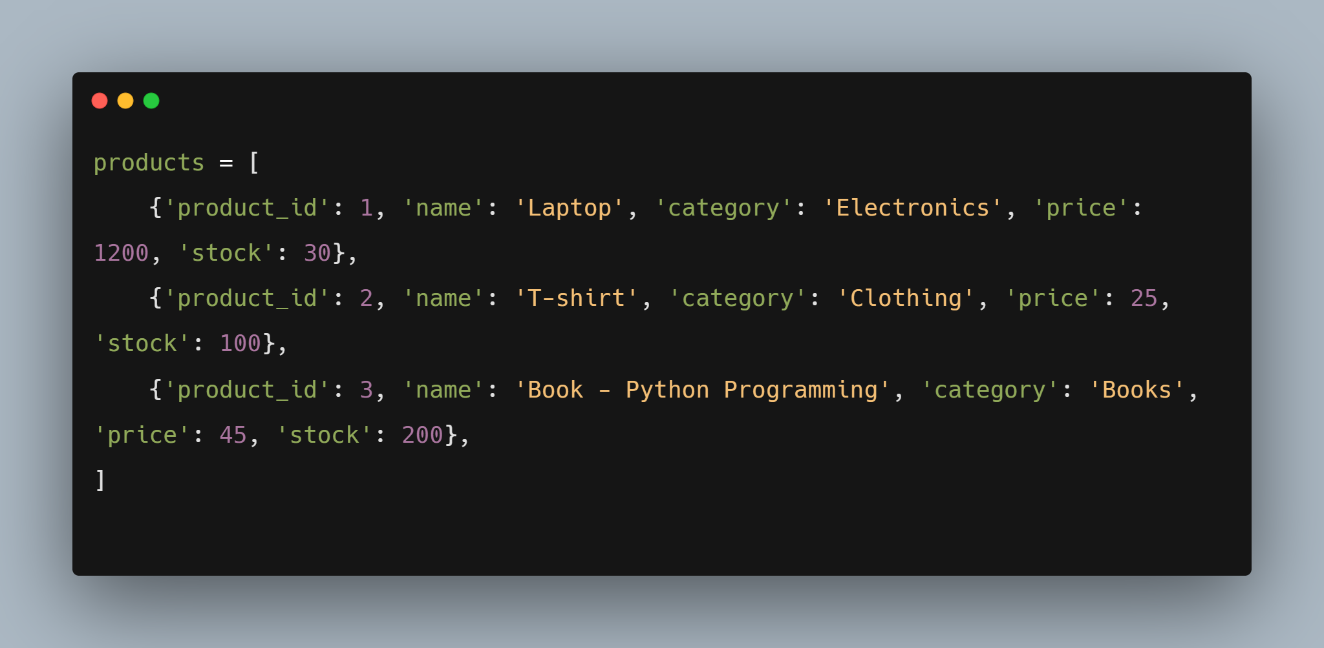
Managing Product Inventory
In this task, we create a list of dictionaries where each dictionary represents a product. Each product has attributes: 'product_id', 'name', 'category', 'price', and 'stock'. Below is an example of creating the product list.
Basic Code for Managing Product Inventory

Slide 5
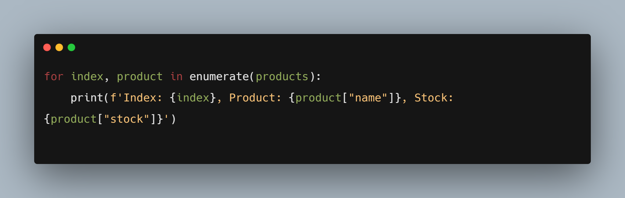
Display Product Information with Enumerate
Use the enumerate function to display the index, product name, and stock in a user-friendly format.
Basic Code for Information with Enumerate

Slide 6
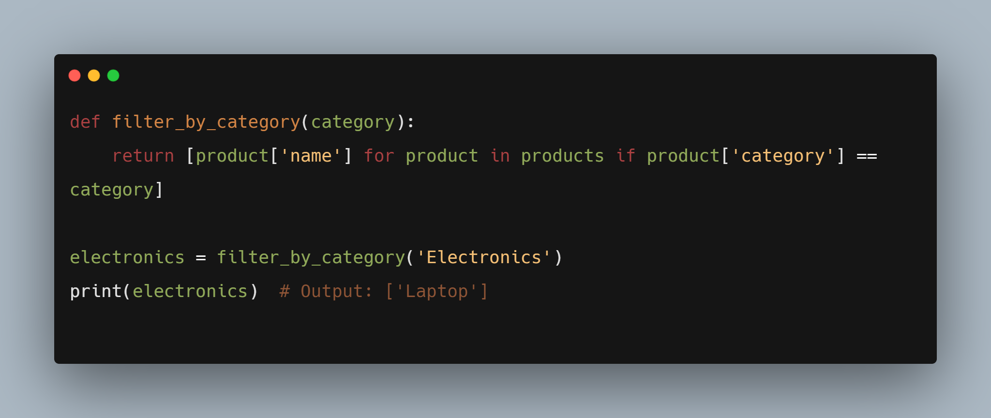
Filtering Products by Category using List Comprehension
Create a function that filters and returns product names based on their category using list comprehension.
Code of Filtering Products by Category using List Comprehension

Slide 7
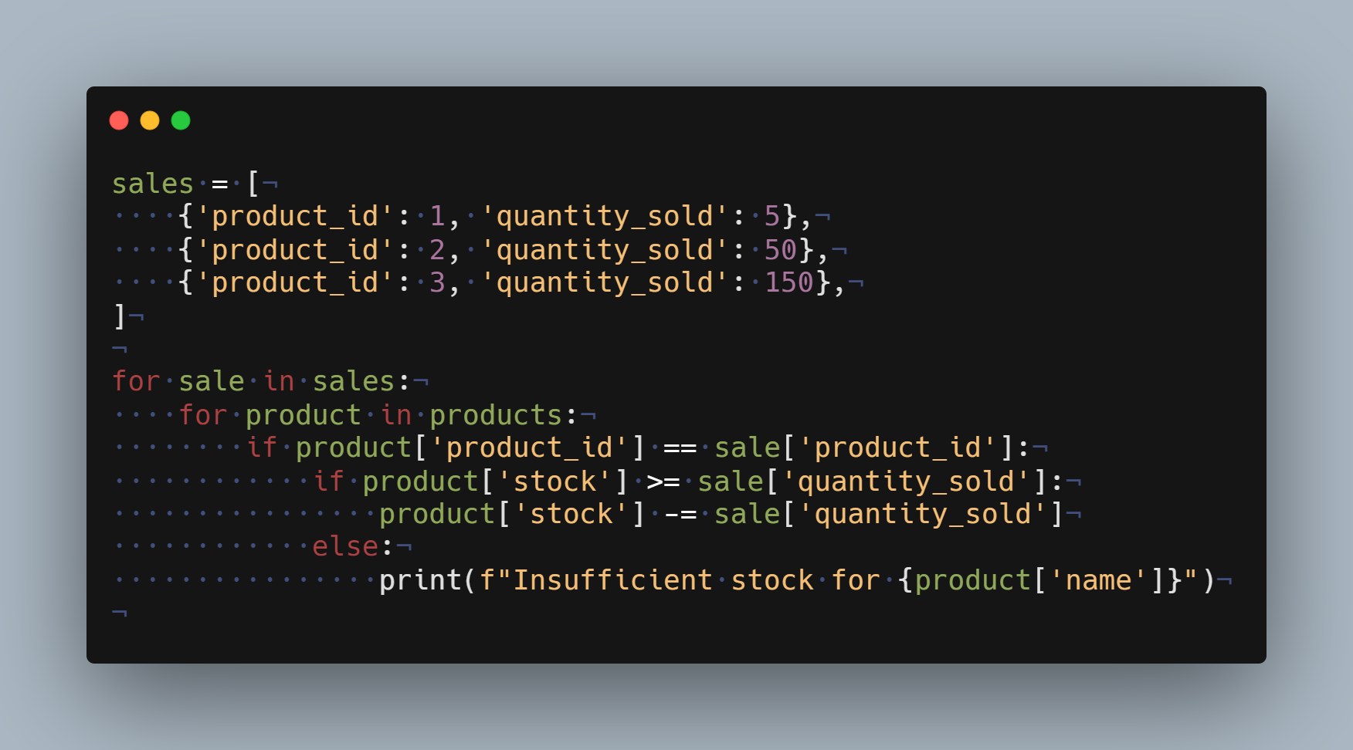
Sales Tracking and Iteration
The company records sales data. You must update the stock for each product sold by iterating over the sales list.
Code of Sales Tracking and Iteration

Slide 8
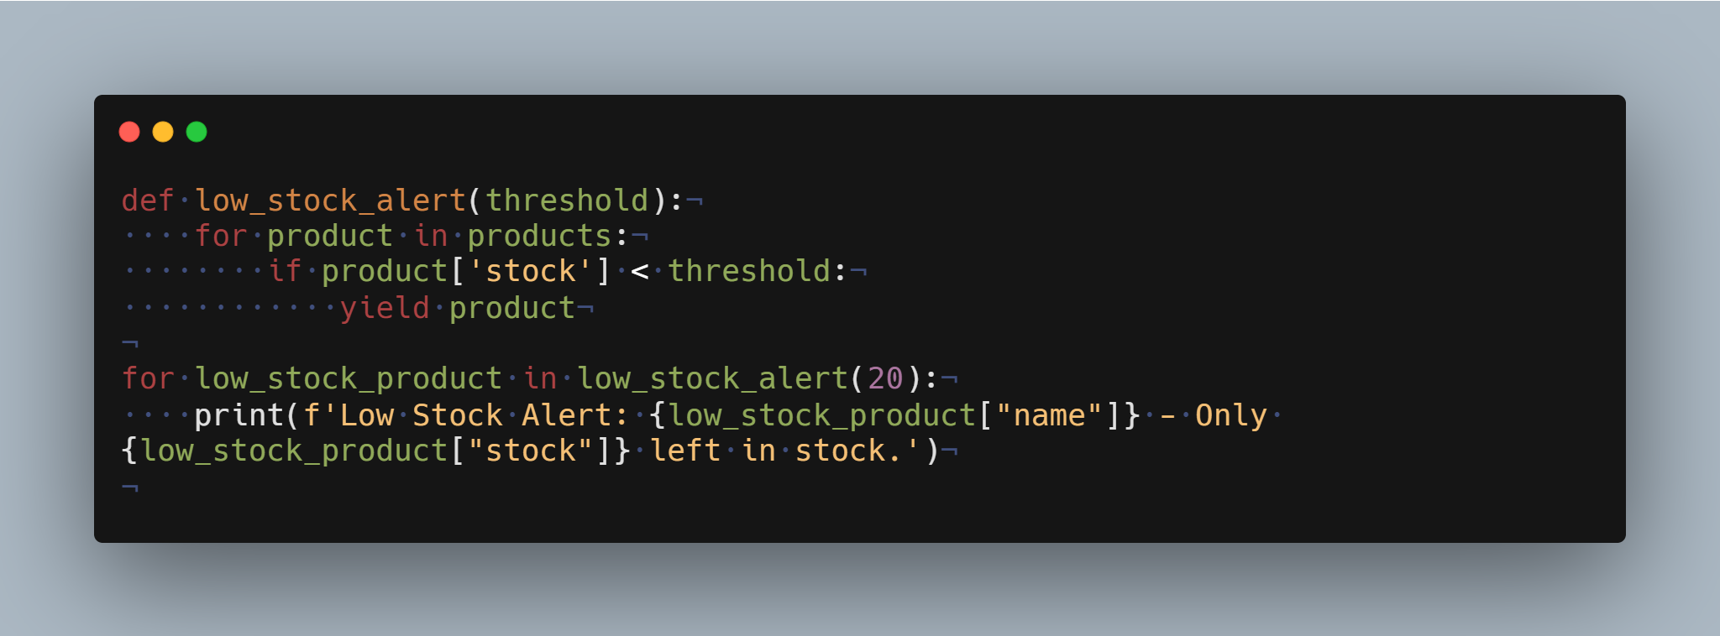
Generating a Low Stock Alert using Iterators
Create an iterator to generate a report of products with low stock
Code of Generating a Low Stock Alert using Iterators

Slide 9
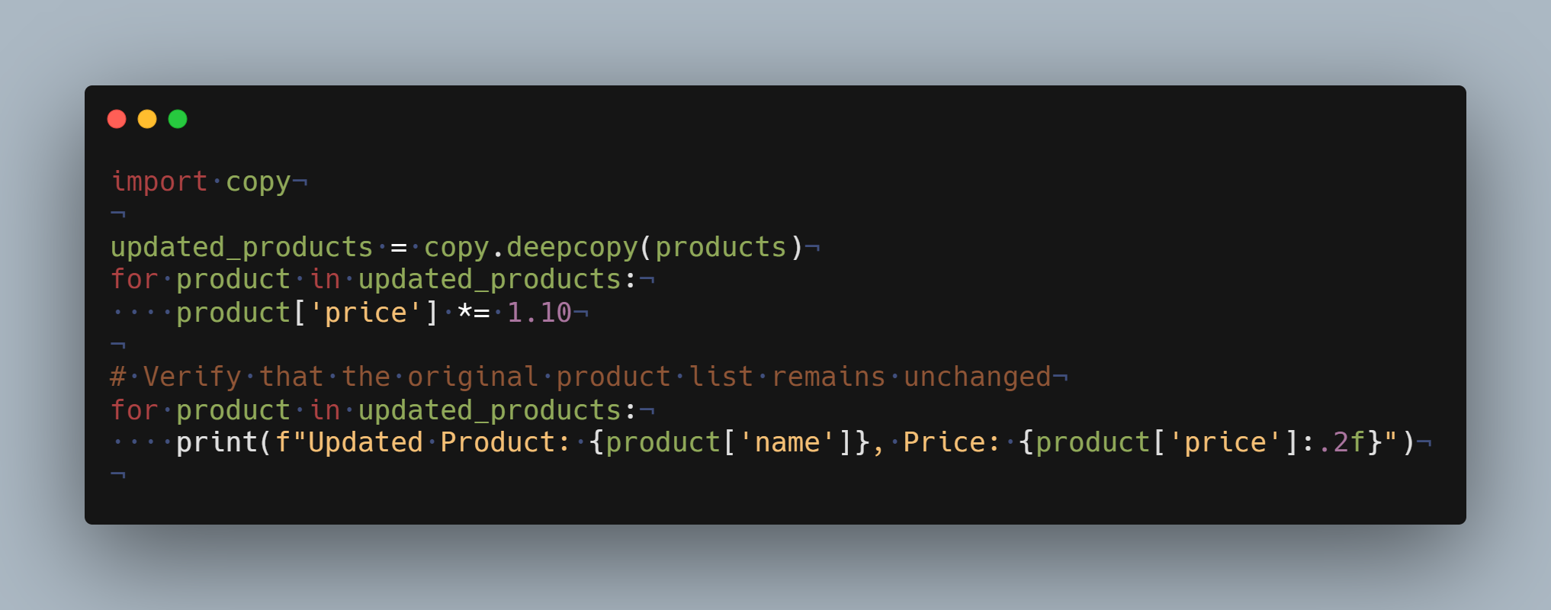
Reference vs Value Types - Deep Copying Product List
Perform a deep copy of the product list and apply a 10% price increase to the copied list.
Code of Deep Copying Product List

Slide 10
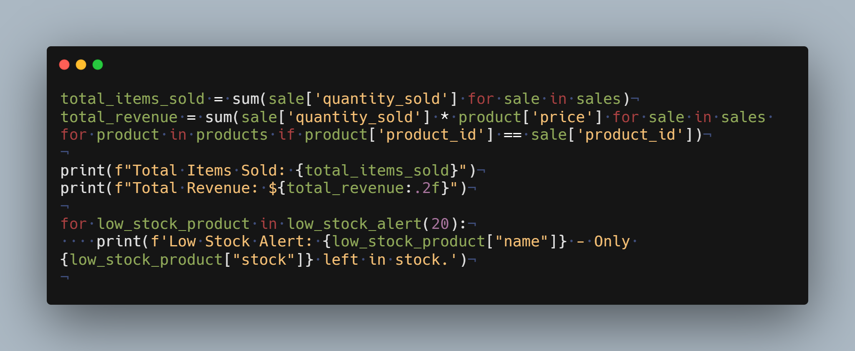
Comprehensive Report Generation
Generate a comprehensive report with updated prices, total items sold, total revenue, and low stock alerts.
Code of Comprehensive Report Generation

